Slide 1

On Becoming a Leader in Risk Management
ENGG 404 - Lecture
ENGG 404 Course Syllabus and Exam Expectations (at LAC using eClass)
1
Notes:
ENGG404 Lecture 00 - Day 1
1
1

Slide 2
Course Syllabus
Learning Outcomes of this Chapter:
Explain how to find key information about the course.
Explain the key points in the Syllabus.
Explain how to navigate on eClass for this course.
2
Notes:
ENGG406 2015WENGG406 Lecture 00 - Day 1
2
2

Slide 3
Course Syllabus
Welcome to Leadership in Risk Management
“As future engineering and business leaders, you will be confronted with a myriad of risks …
Your job will be to manage those risks — all of them.
Limited success with focus financial risk …
Miserable failure if “something bad happens”
3
Notes:
3

Slide 4
Course Syllabus
Class and Instructor Information:
The School of Engineering Safety and Risk Management:
Professor Winkel, P.Eng., M.Sc.Eng.;
Director, Industrial Professor
Professor Cocchio, P. Eng., MBA;
Industrial Professor
Dr. Lefsrud, PhD, P.Eng.;
Assistant Professor
Dr. Macciotta, PhD, P.Eng.;
Industrial Professor
Dr. White, PhD, P.Eng.;
Industrial Professor
Professor Coles, P.Eng., M.Eng.;
Associate Director, Industrial Professor
4
Notes:
4

Slide 5

Course Syllabus
Mentimeter Ground Rules:
Before you Menti!
Honest? Sincere?
Builds on the question?
Thoughtful? Intellectual?
Meaningful?
Considerate? Polite? Respectful?
5
Notes:
5

Slide 6

Course Syllabus
Course Information:
Most questions pertain to:
Seminars:
Marks and Deductions
Course Plan
eClass and Exams
Answers:
All in the Syllabus
Highlights presented here …
6
Notes:
6

Slide 7
Course Syllabus
Course Information:
Seminar Periods, starting in Week 3 Seminar, are used for instruction on the team project content:
Dates are posted on the Course Plan
Work on your team project; thus, you MUST attend the seminar in which you are registered
Most seminars are mandatory attendance as stated in the Course Plan.
7
Notes:
7

Slide 8
Course Syllabus
Marking Scheme – the Allocation of Course Marks:
Item | Marks
On-line Quizzes (0.5% per on-line quiz, 12 total) | 6%
Assignment #1 | 2%
Assignment #2 | 2%
Mid-Term | 10%
Team Project (Progress Report 5% + Final Report 20%) | 25%
In-class Quizzes (0.5% per in-class quiz, 10 total) | 5%
Final Exam | 50%
Deductions: | variable
Total (less any applicable deductions): | 100%
8
Notes:
8

Slide 9
Course Syllabus
Marking Scheme – the Allocation of Course Marks:
Lots of information in the Syllabus.
Key point:
Deductions:
Late or missed submissions – assignments, quizzes
Lack of seminar attendance
Not completing the ITP Metrics Peer Feedback Surveys,
Lack of participation/contribution on the Team Project.
9
Notes:
9

Slide 10
Course Syllabus
Textbook:
“A Handbook for Becoming a Leader in Risk Management”
Available as a pdf on eClass.
Supplements learning … goes hand-in-glove / provides the basis for in-class active learning exercises that facilitate your learning.
Will be a great resource in your future roles in your career.
10
Notes:
10

Slide 11
Course Syllabus
University Policies:
Academic Integrity: The University of Alberta is committed to the highest standards of academic integrity and honesty. Students are expected to be familiar with these standards regarding academic honesty and to uphold the policies of the University in this respect.
The Code of Student Behaviour: https://www.ualberta.ca/governance/resources/policies-standards-and-codes-of-conduct/code-of-student-behaviour
Avoid any behaviour which could potentially result in suspicions of cheating, plagiarism, misrepresentation of facts and/or participation in an offence.
Academic dishonesty is a serious offence and can result in suspension or expulsion from the University.
11
Notes:
11

Slide 12
Course Syllabus
Course-level Learning Outcomes – Eight of them:
At the end of this course, the student should be able to:
Appraise the safety culture …
Assess and positively influence the safety leadership …
Apply four leadership tools …
Apply incident investigation and root cause analysis tools …
Collaborate in a team …
Integrate and apply lessons learned from others …
Explain relevant portions of the PE Act and the APEGA Code of Ethics ...
Examine a situation where professional conduct and ethics may be called into question …
12
Notes:
12

Slide 13
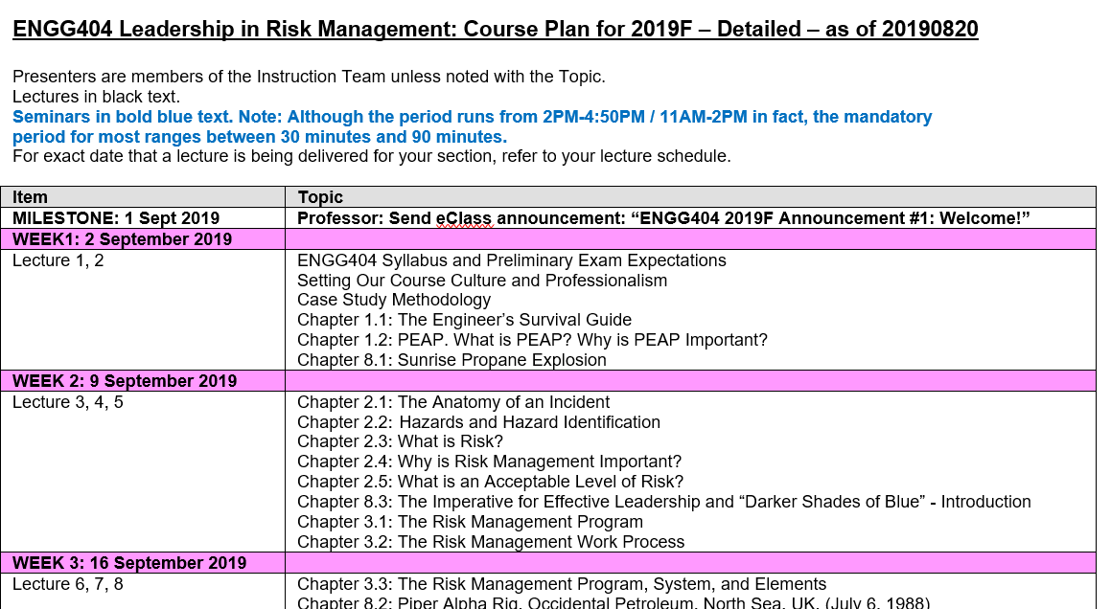
Course Plan:
ENGG 404 Course Plan – posted on eClass.
13
Notes:
13

Slide 14
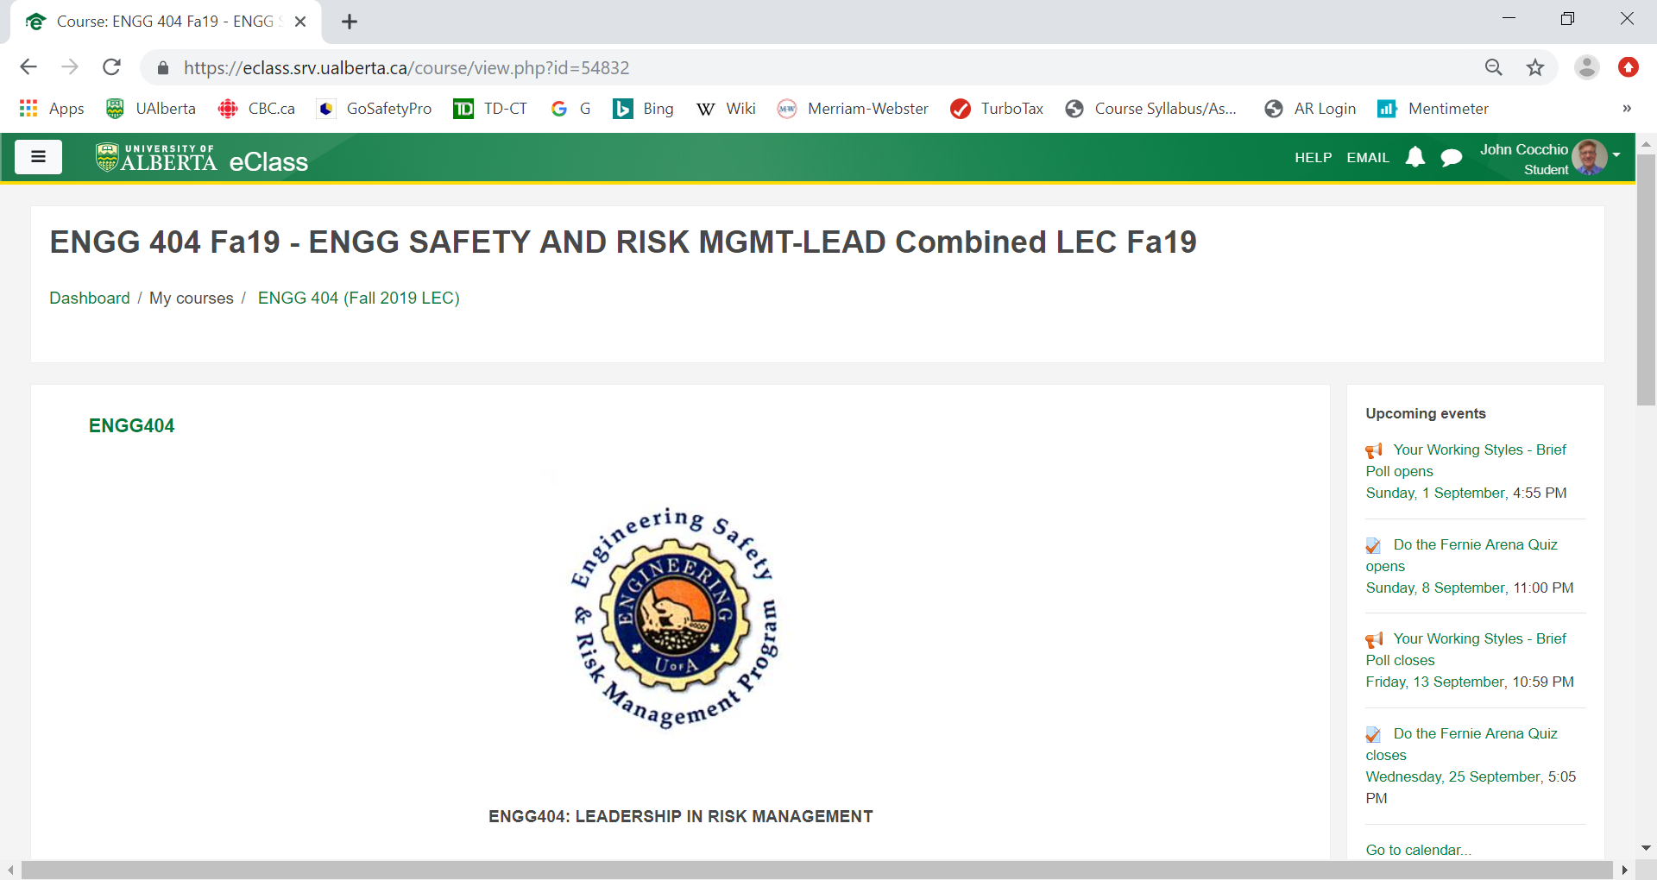
eClass Overview:
Overview of eClass, How Work is Submitted, Exams at LAC:
Overview of eClass
Syllabus, Course Plan, Textbook, etc. are posted on eClass
All work is Submitted on eClass
Exams at LAC and Exam Expectations
14
Notes:
ENGG404 Lecture 00 - Day 1
2012 Fall
14
14

Slide 15
Expectations for the Exam
General Information about the Exams:
Both the Mid-term Exam and the Final Exam are administered through the Learning Assessment Centre (LAC) using the MOODLE-eClass platform on secured work-stations (desk-top computers).
Within the first few weeks of the course, you will receive an email from The LAC that will direct you to sign onto the LAC booking site, and book your preferred time for writing the exam.
At a timely point before the exams, you will receive further instructions.
For more information at this time, refer to this section on eClass: Important Information About the Final Examination Dates and Students' Responsibilities
ESRM-LRM
15
Notes:
15

